Slide 1
Ayodhya Ram Temple SQL Analysis
Link : https://bit.ly/3u70dJJ (credits : Digits n Data)

Slide 2
Tables used:
Deity
Temple
ConstructionPhase
Architecture
Donations
Events
TempleEvents

Slide 3
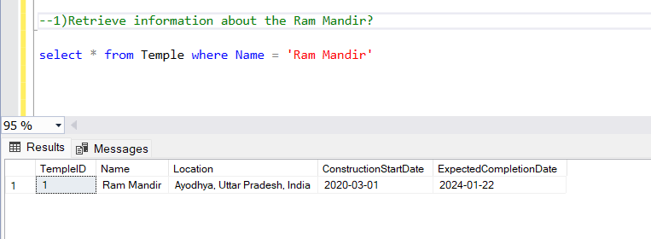
1)Retrieve information about the Ram Mandir?

Slide 4
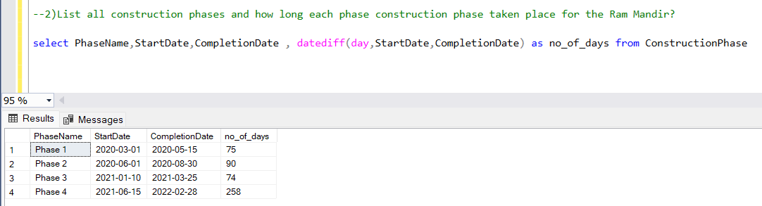
2)List all construction phases and how long each phase construction phase taken place for the Ram Mandir?

Slide 5
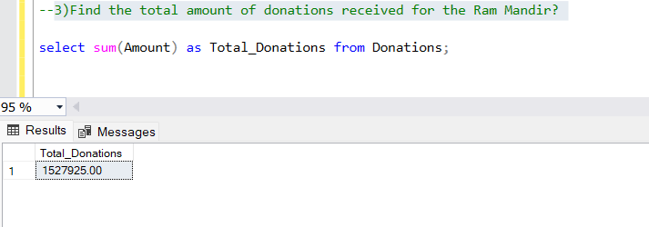
3)Find the total amount of donations received for the Ram Mandir?

Slide 6
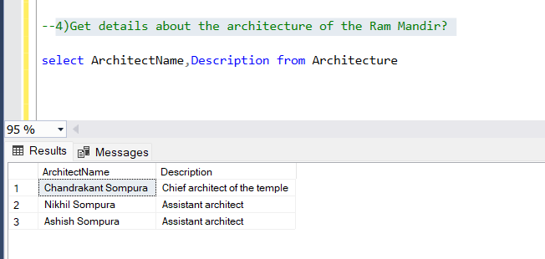
4)Get details about the architecture of the Ram Mandir?

Slide 7
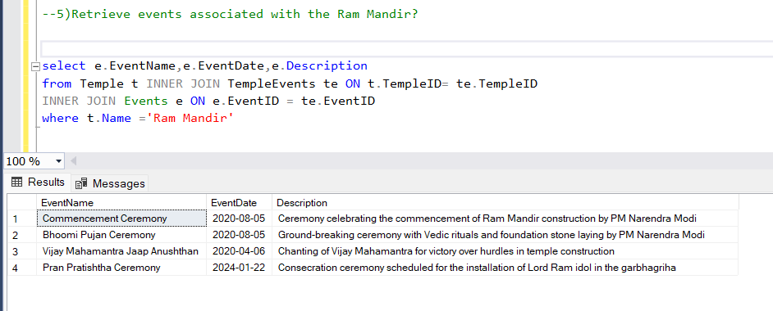
5)Retrieve events associated with the Ram Mandir?

Slide 8
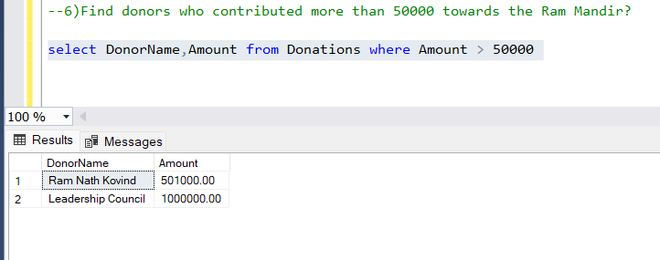
6)Find donors who contributed more than 50000 towards the Ram Mandir?

Slide 9
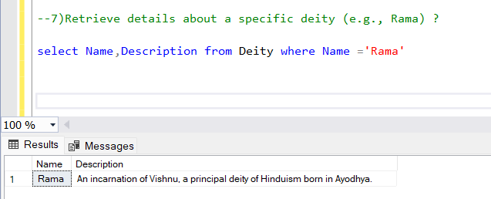
7)Retrieve details about a specific deity (e.g., Rama) ?

Slide 10
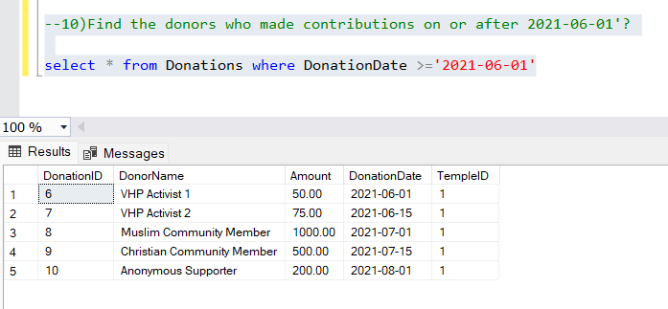
8)Find the donors who made contributions on or after 2021-06-01'?

Slide 11
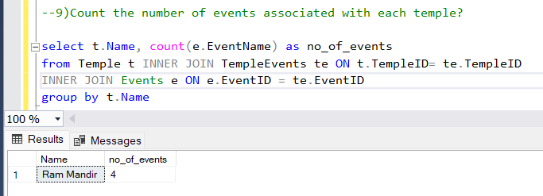
9)Count the number of events associated with each temple?

Slide 12
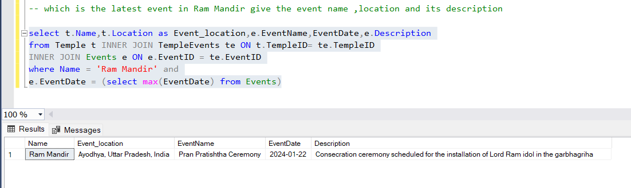
10) which is the latest event in Ram Mandir give the event name, location and its description

